Slide 1
Word DOCX
Notes:
[Mandatory Slide] This would be the introduction slide of the topic that you are covering in this subsection.
When this slide plays, you could talk about the main aim that we’d be covering in this video.

Slide 2
In this Video, we are going to take a look at…
The Word DOCX format
Libraries to work with Word DOCX
Code: read and write a Word DOCX file
Notes:
[Mandatory Slide]
Before the start of the video, we’d like to highlight what are important topics or pointers that we’d be covering in this video. This slide would immediately follow the intro/name slide. This would just be say 2-3 points for the viewers to know what they are getting into.

Slide 3
The Word DOCX format (1/2)
The DOCX format is a binary file format (once proprietary to Microsoft©) used by the Word text-processor
Features:
A Word document can be represented like a XML structure
The root element is a collection of Paragraph objects
Paragraphs are text chunks divided by line break characters
Each Paragraph has one or more Run objects: a Run contains contiguous text with the same style
A Style is a collection of color, size and font that can be given both to Paragaphs and Runs
Notes:
This slide can also be used to cover topics that can be represented by an image/graph etc. Information which is half image/half information type. Like shown in the example above.

Slide 4
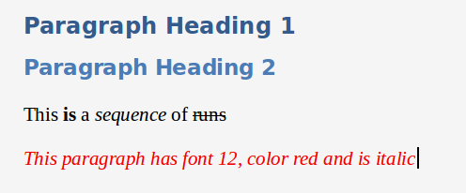
The Word DOCX format (2/2)
PARAGRAPHS
STYLES APPLIED TO RUNS
RUNS
STYLES APPLIED TO PARAGRAPHS
Notes:
[Mandatory Slide]
Before the start of the video, we’d like to highlight what are important topics or pointers that we’d be covering in this video. This slide would immediately follow the intro/name slide. This would just be say 2-3 points for the viewers to know what they are getting into.

Slide 5
Libraries to work with Word DOCX
We’ll use the python-docx in our code sample
Notes:
[Mandatory Slide]
Before the start of the video, we’d like to highlight what are important topics or pointers that we’d be covering in this video. This slide would immediately follow the intro/name slide. This would just be say 2-3 points for the viewers to know what they are getting into.

Slide 6
Code: read and write
a Word DOCX file
Notes:
Something that needs to grab the viewers attention!!

Slide 7
Summary
The Word DOCX format
Libraries to work with Word DOCX
Code: read and write a Word DOCX file
Notes:
This slide, like mentioned is to summarize the various videos we have seen in this section. This gives the viewers a sense of achievement that they have covered exactly what they were looking for.

Slide 8
Excel XLSX
Next Video
Notes:
[Mandatory Slide]
Here the name of the next video needs to be mentioned. The narration as you guessed it would be just letting the viewer know exactly where we are at and what we’d be taking over next! ☺

